Slide 1


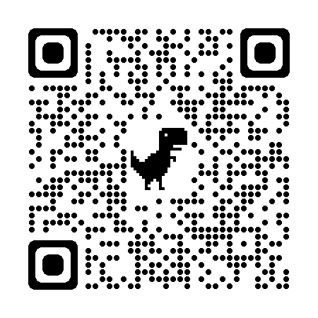
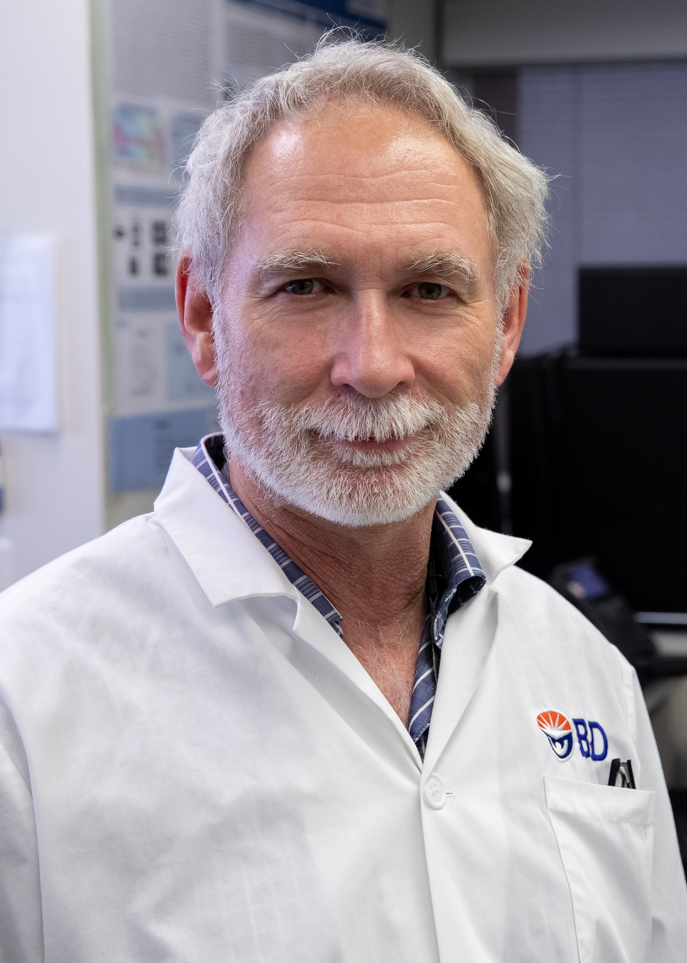
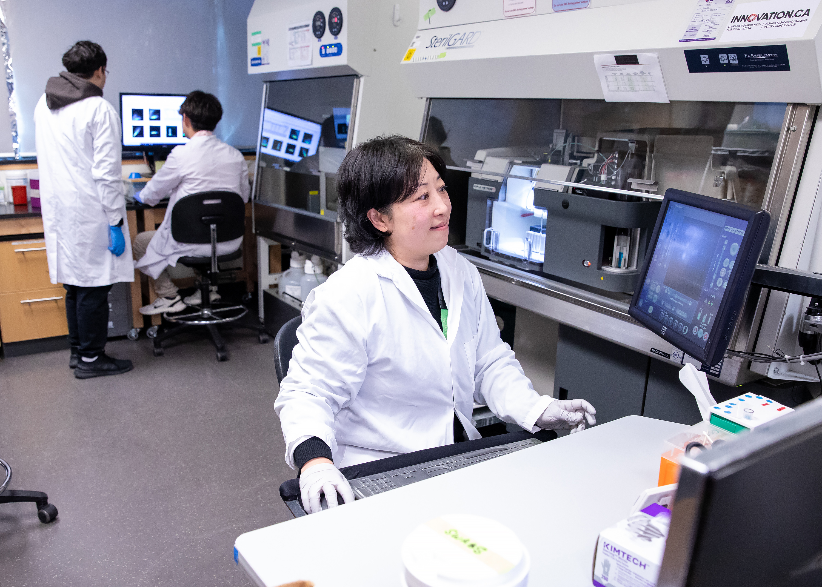
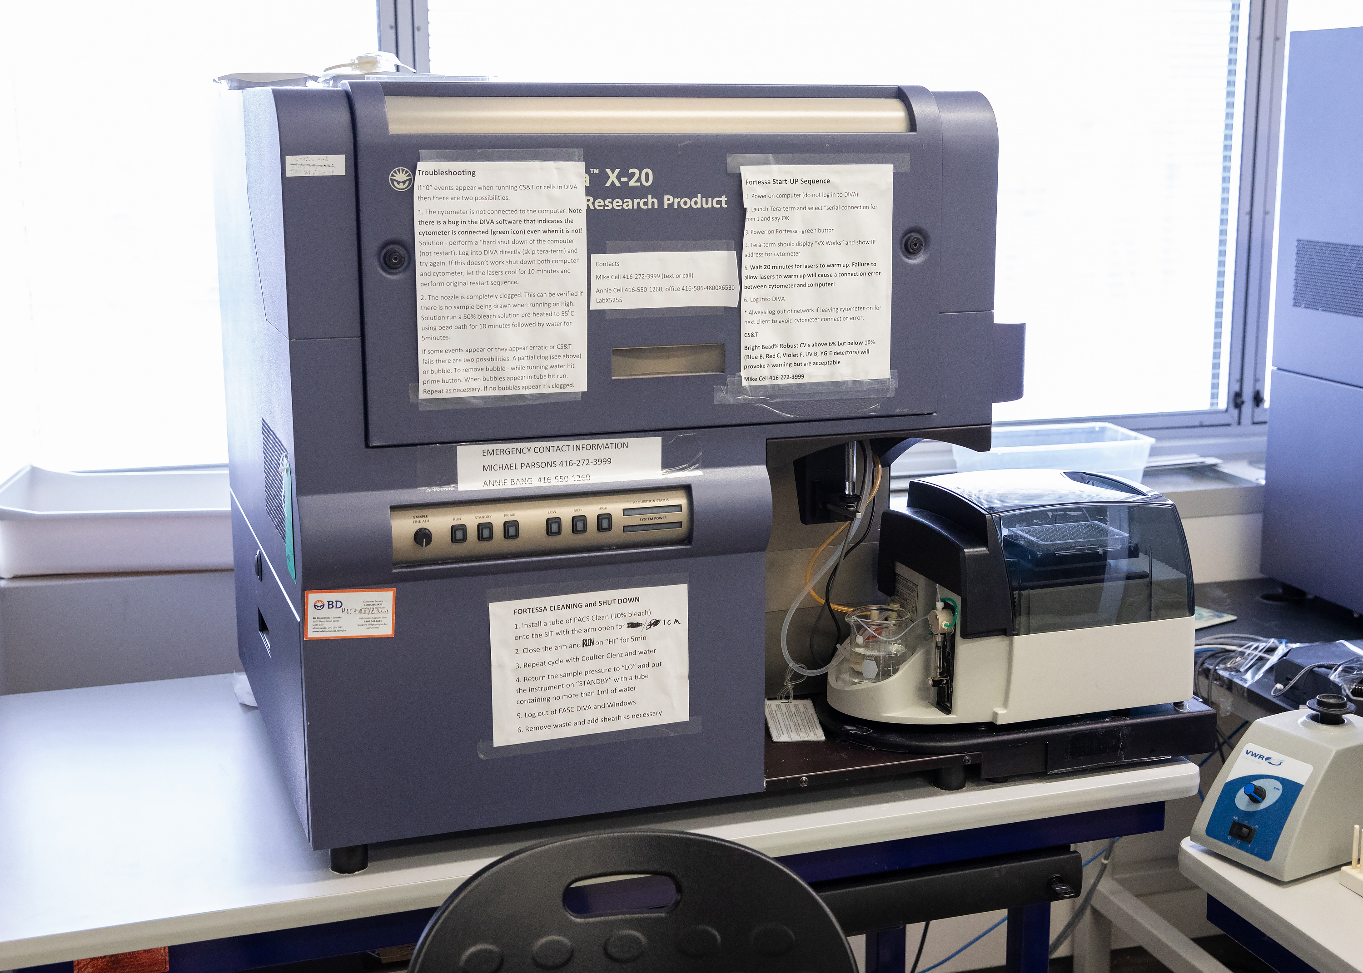
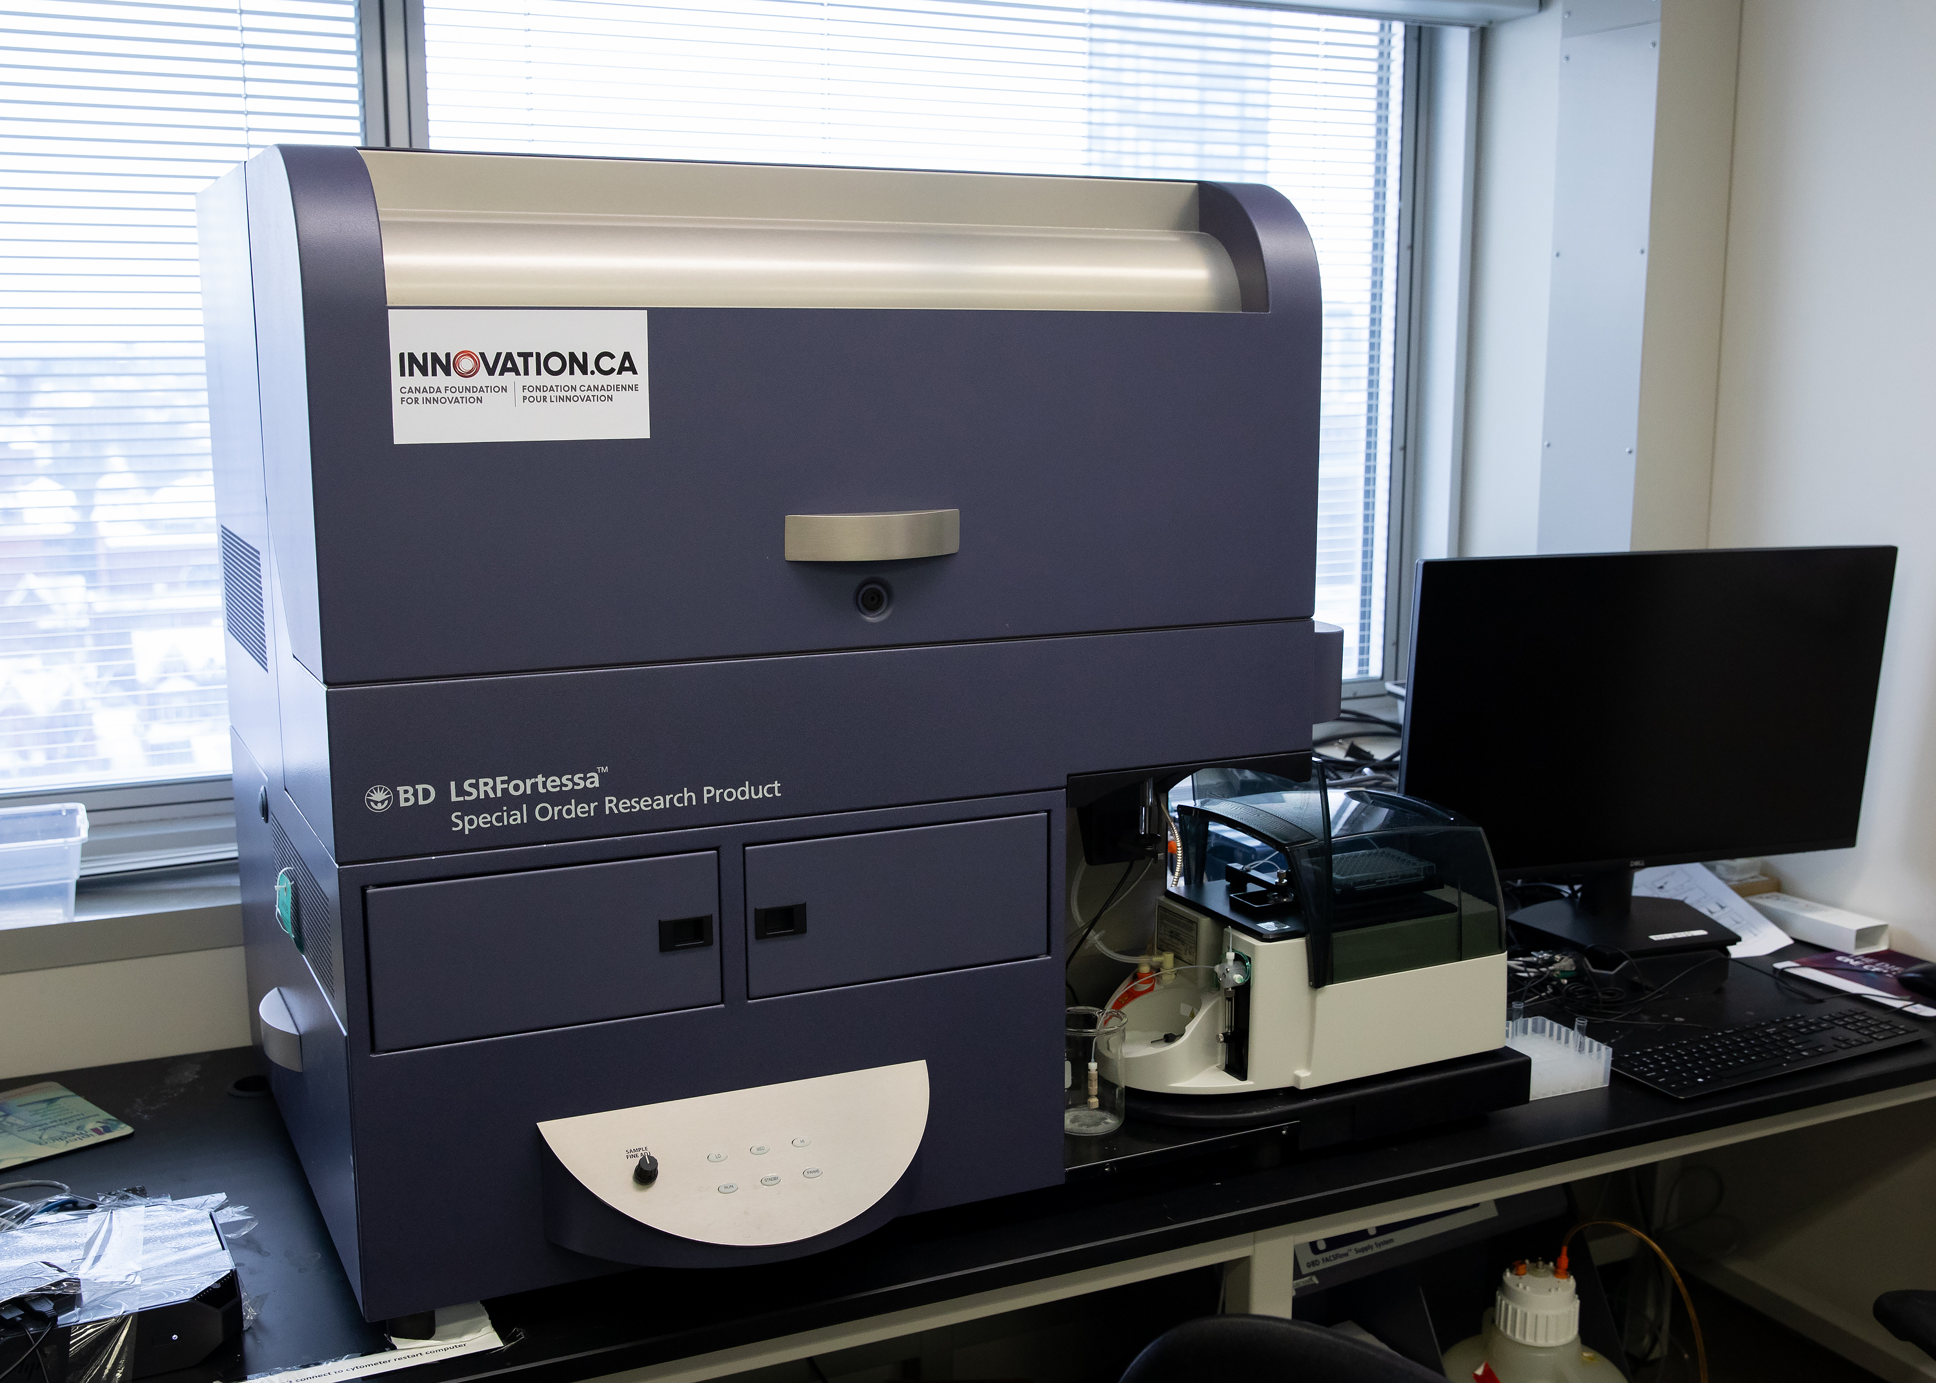
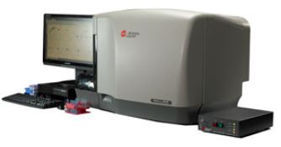
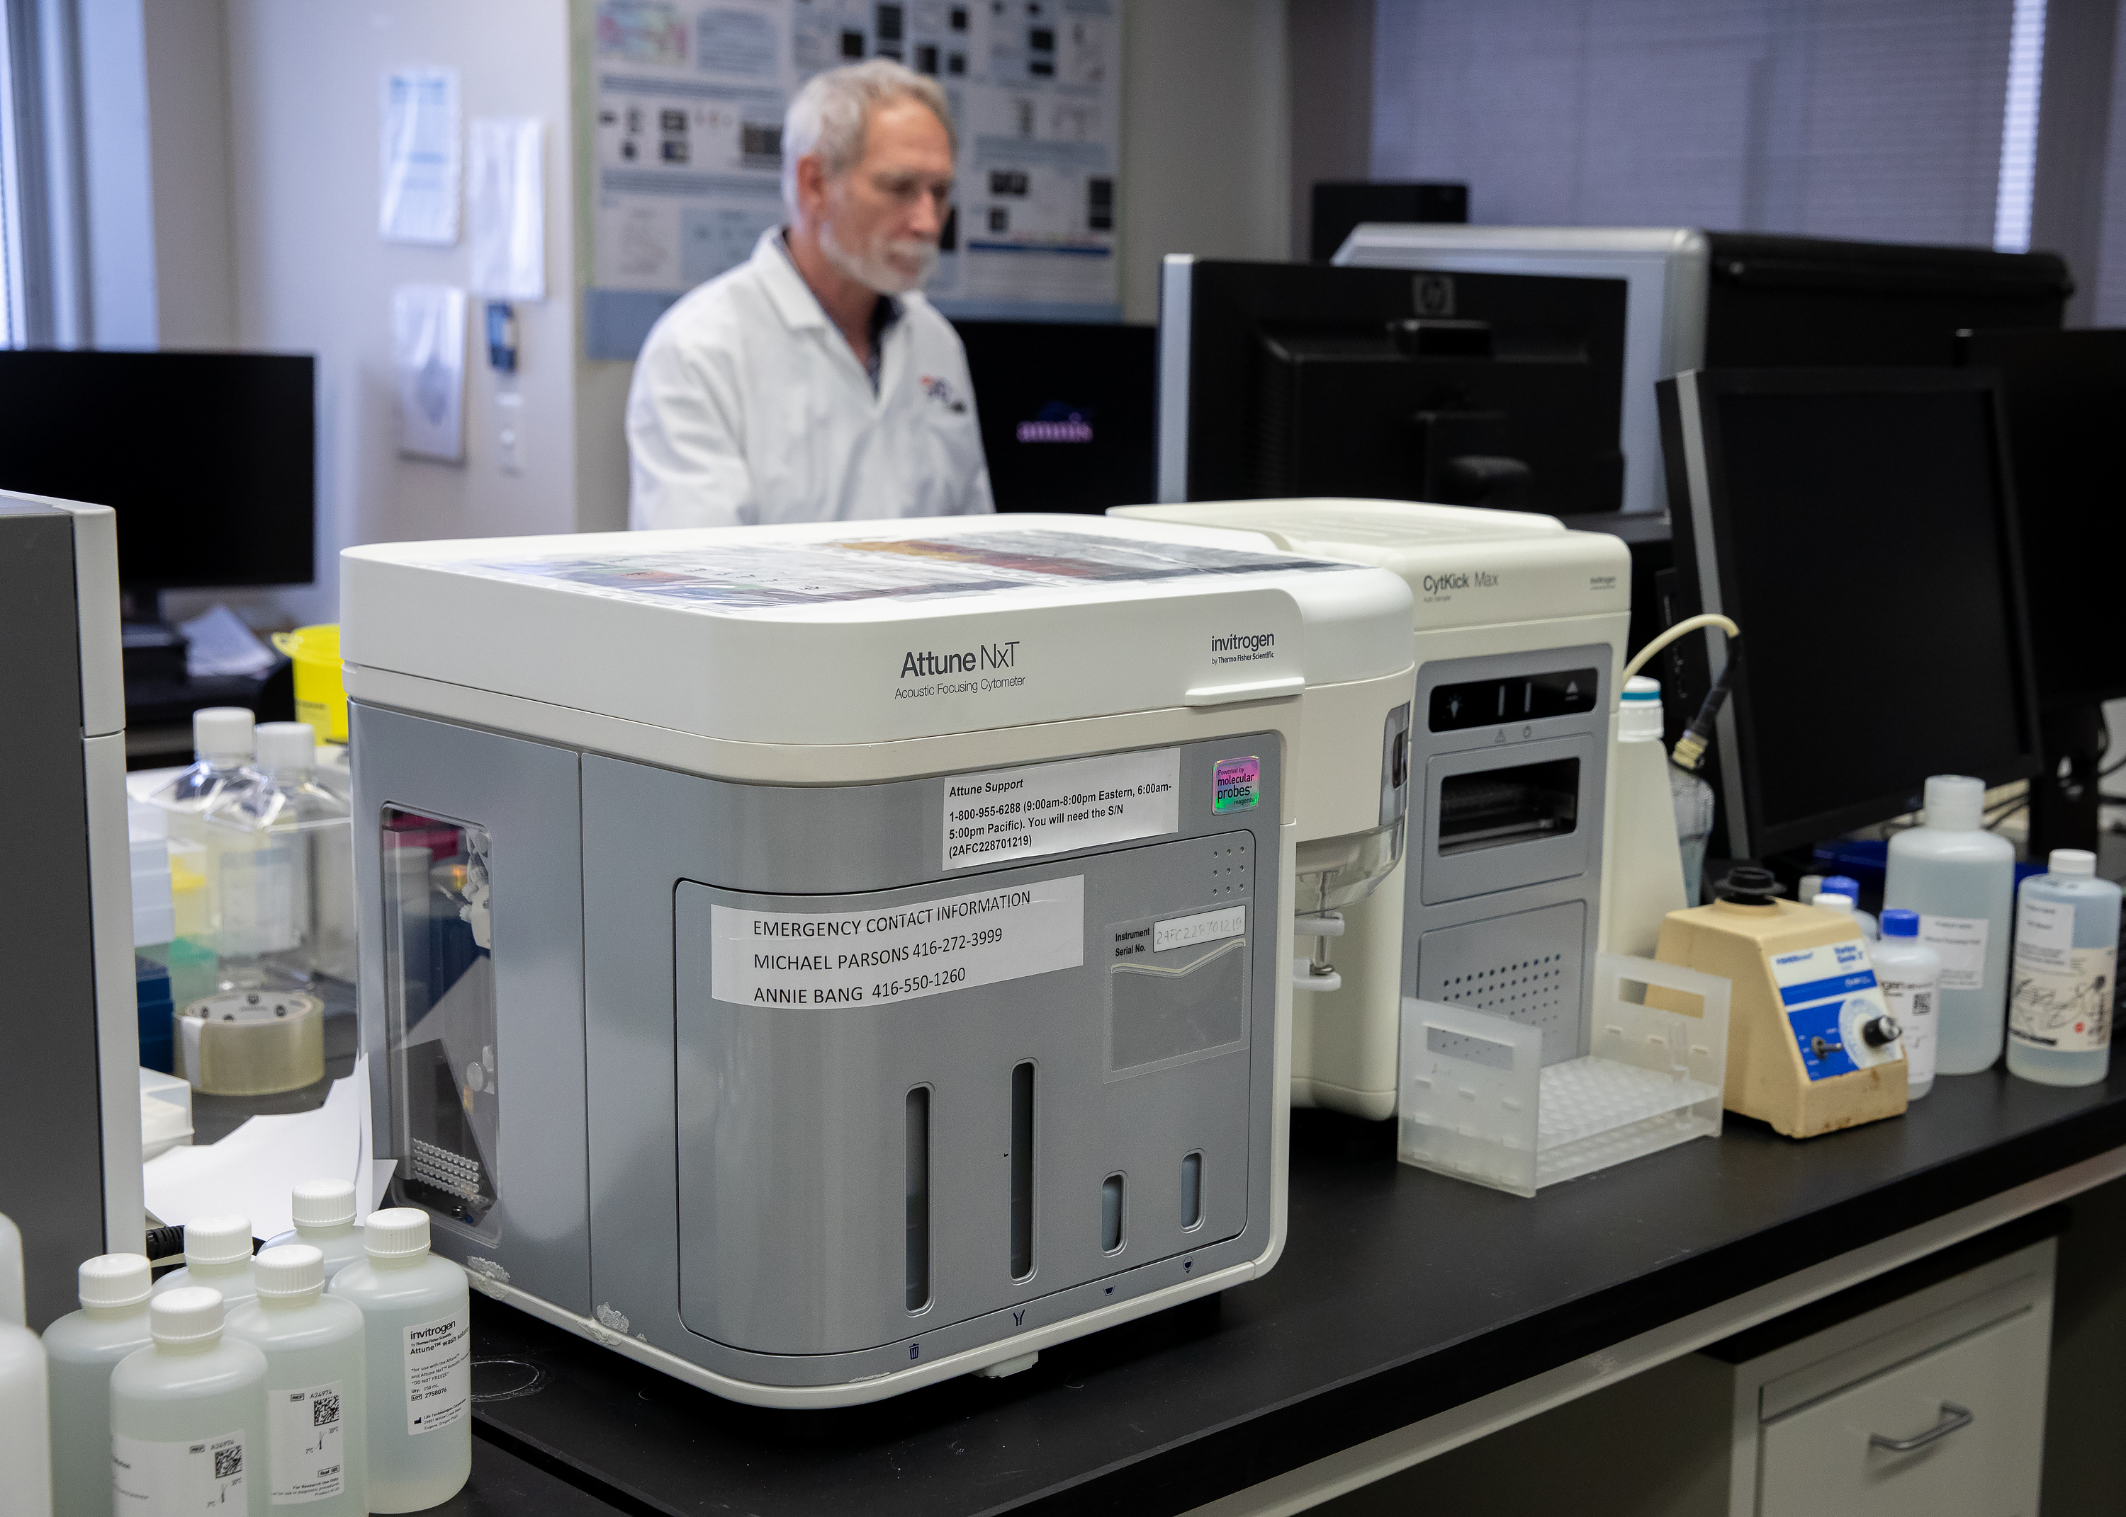
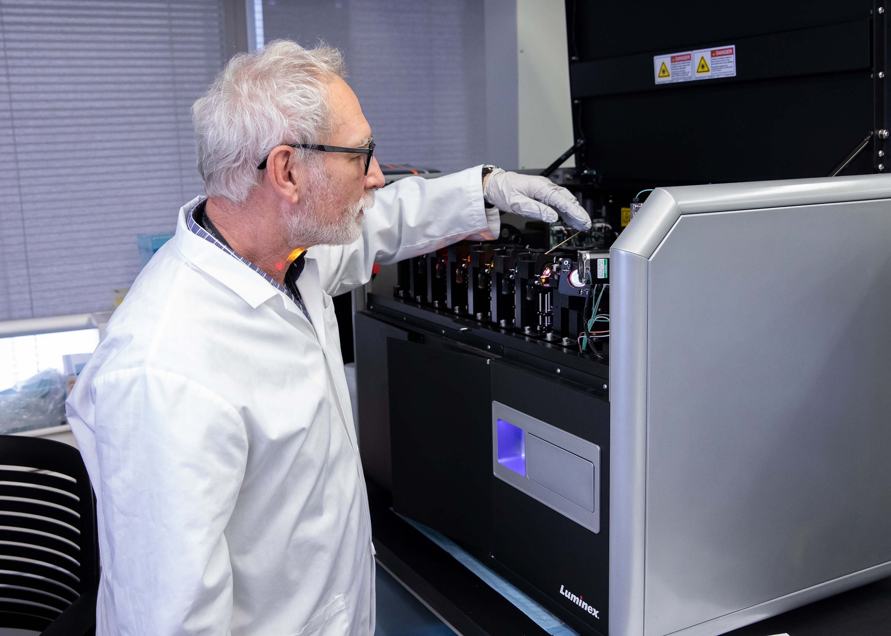
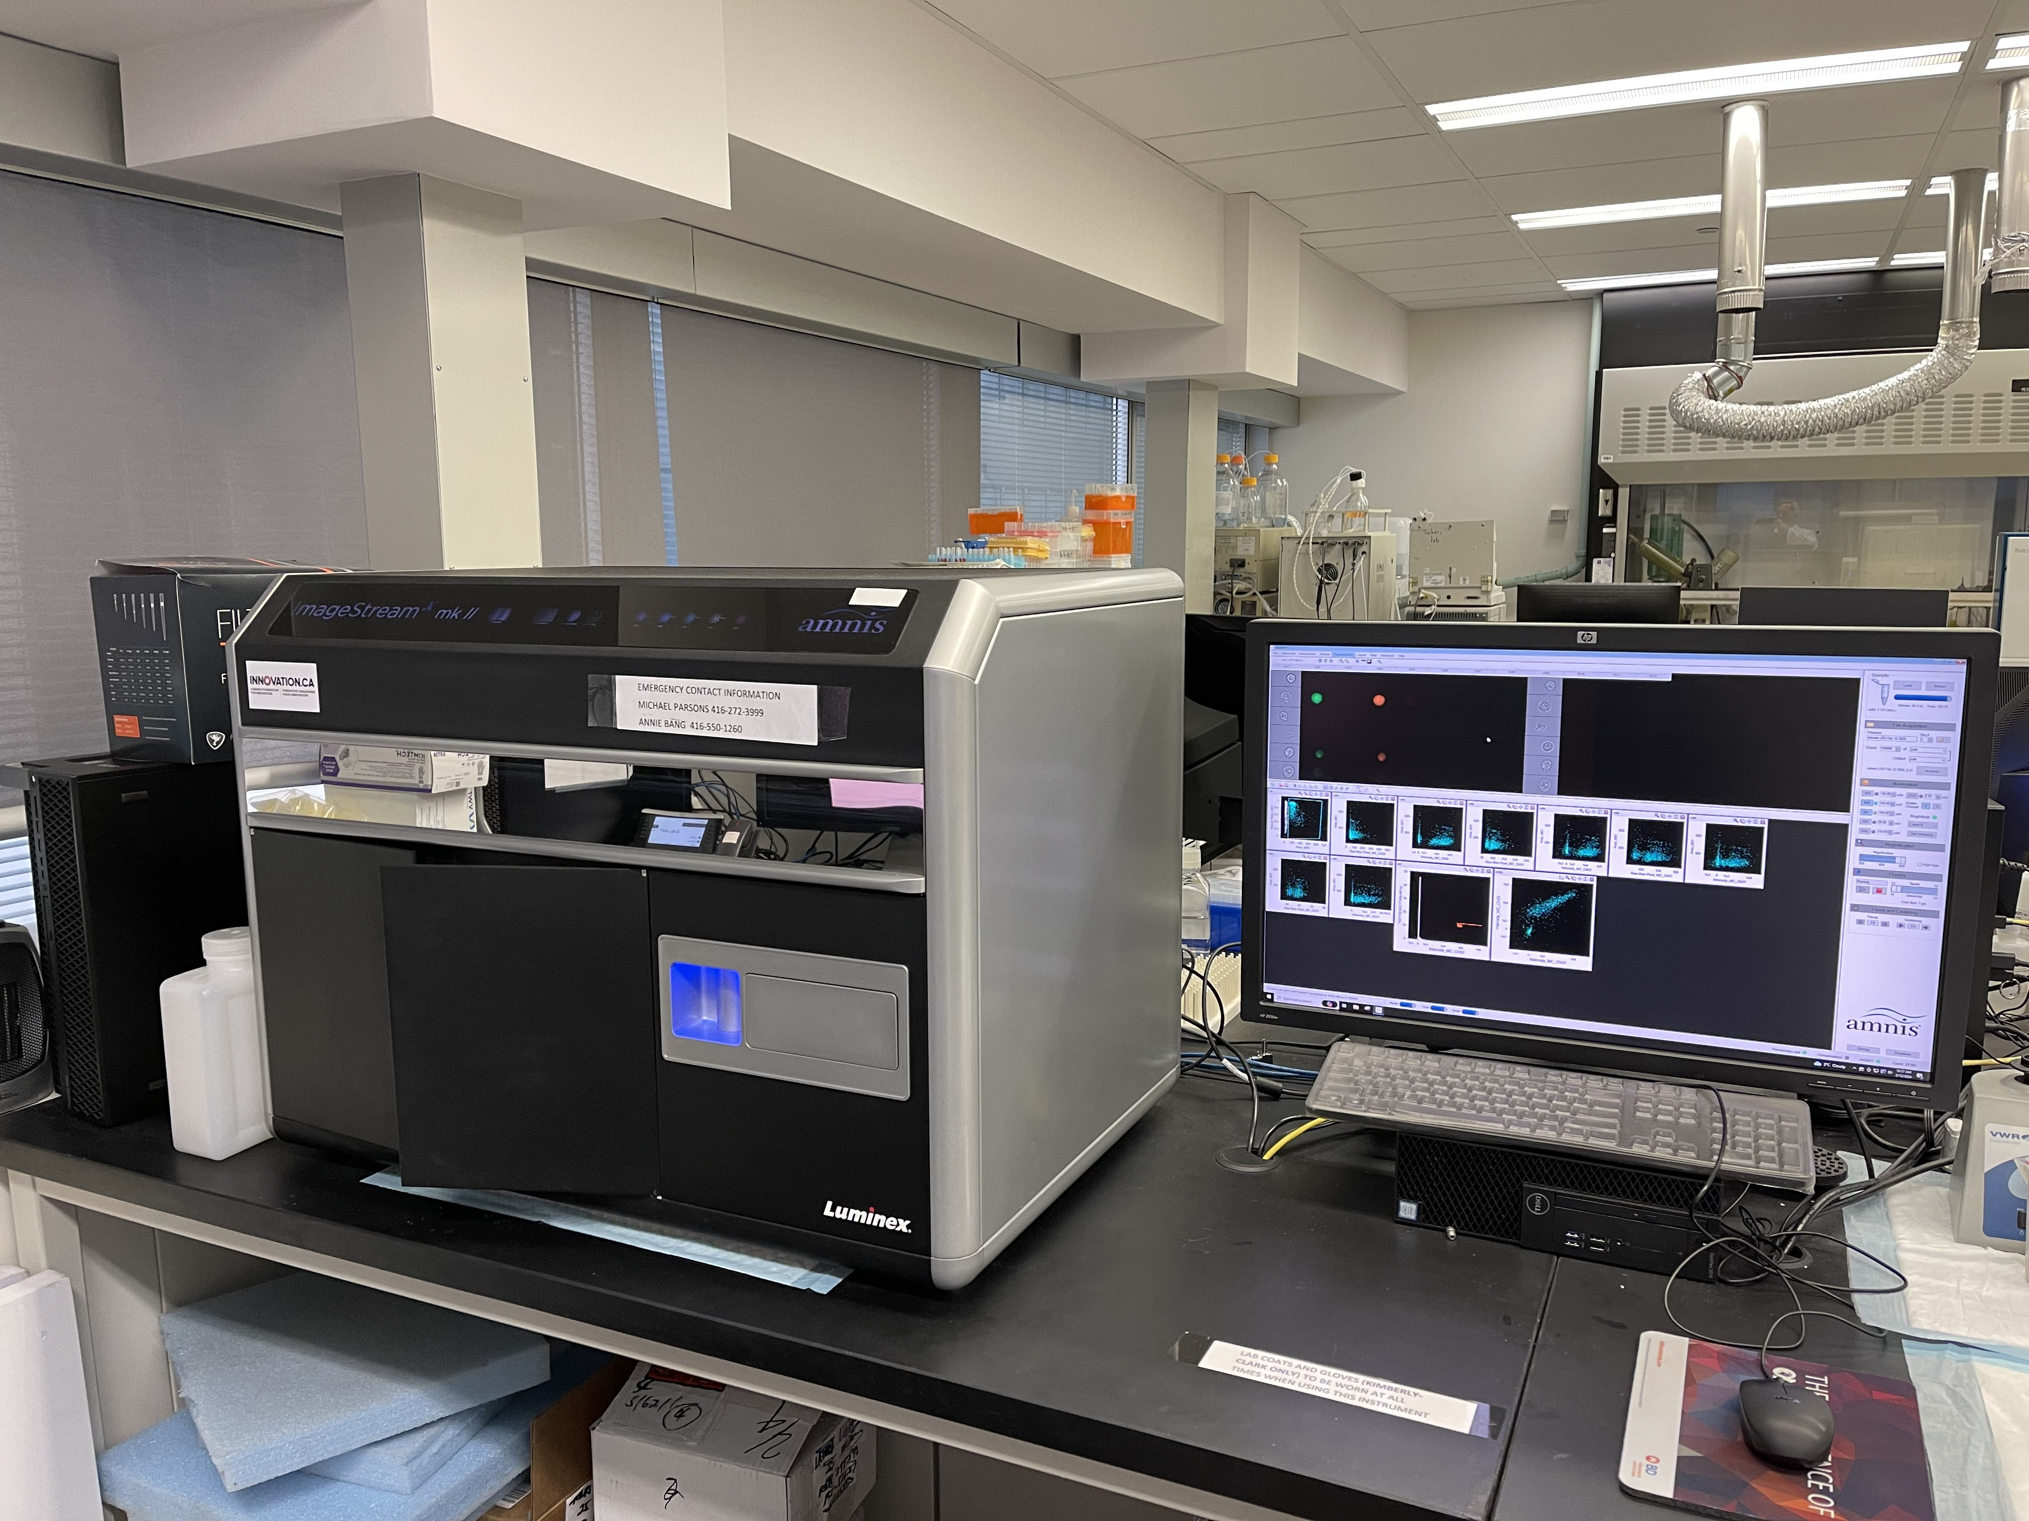
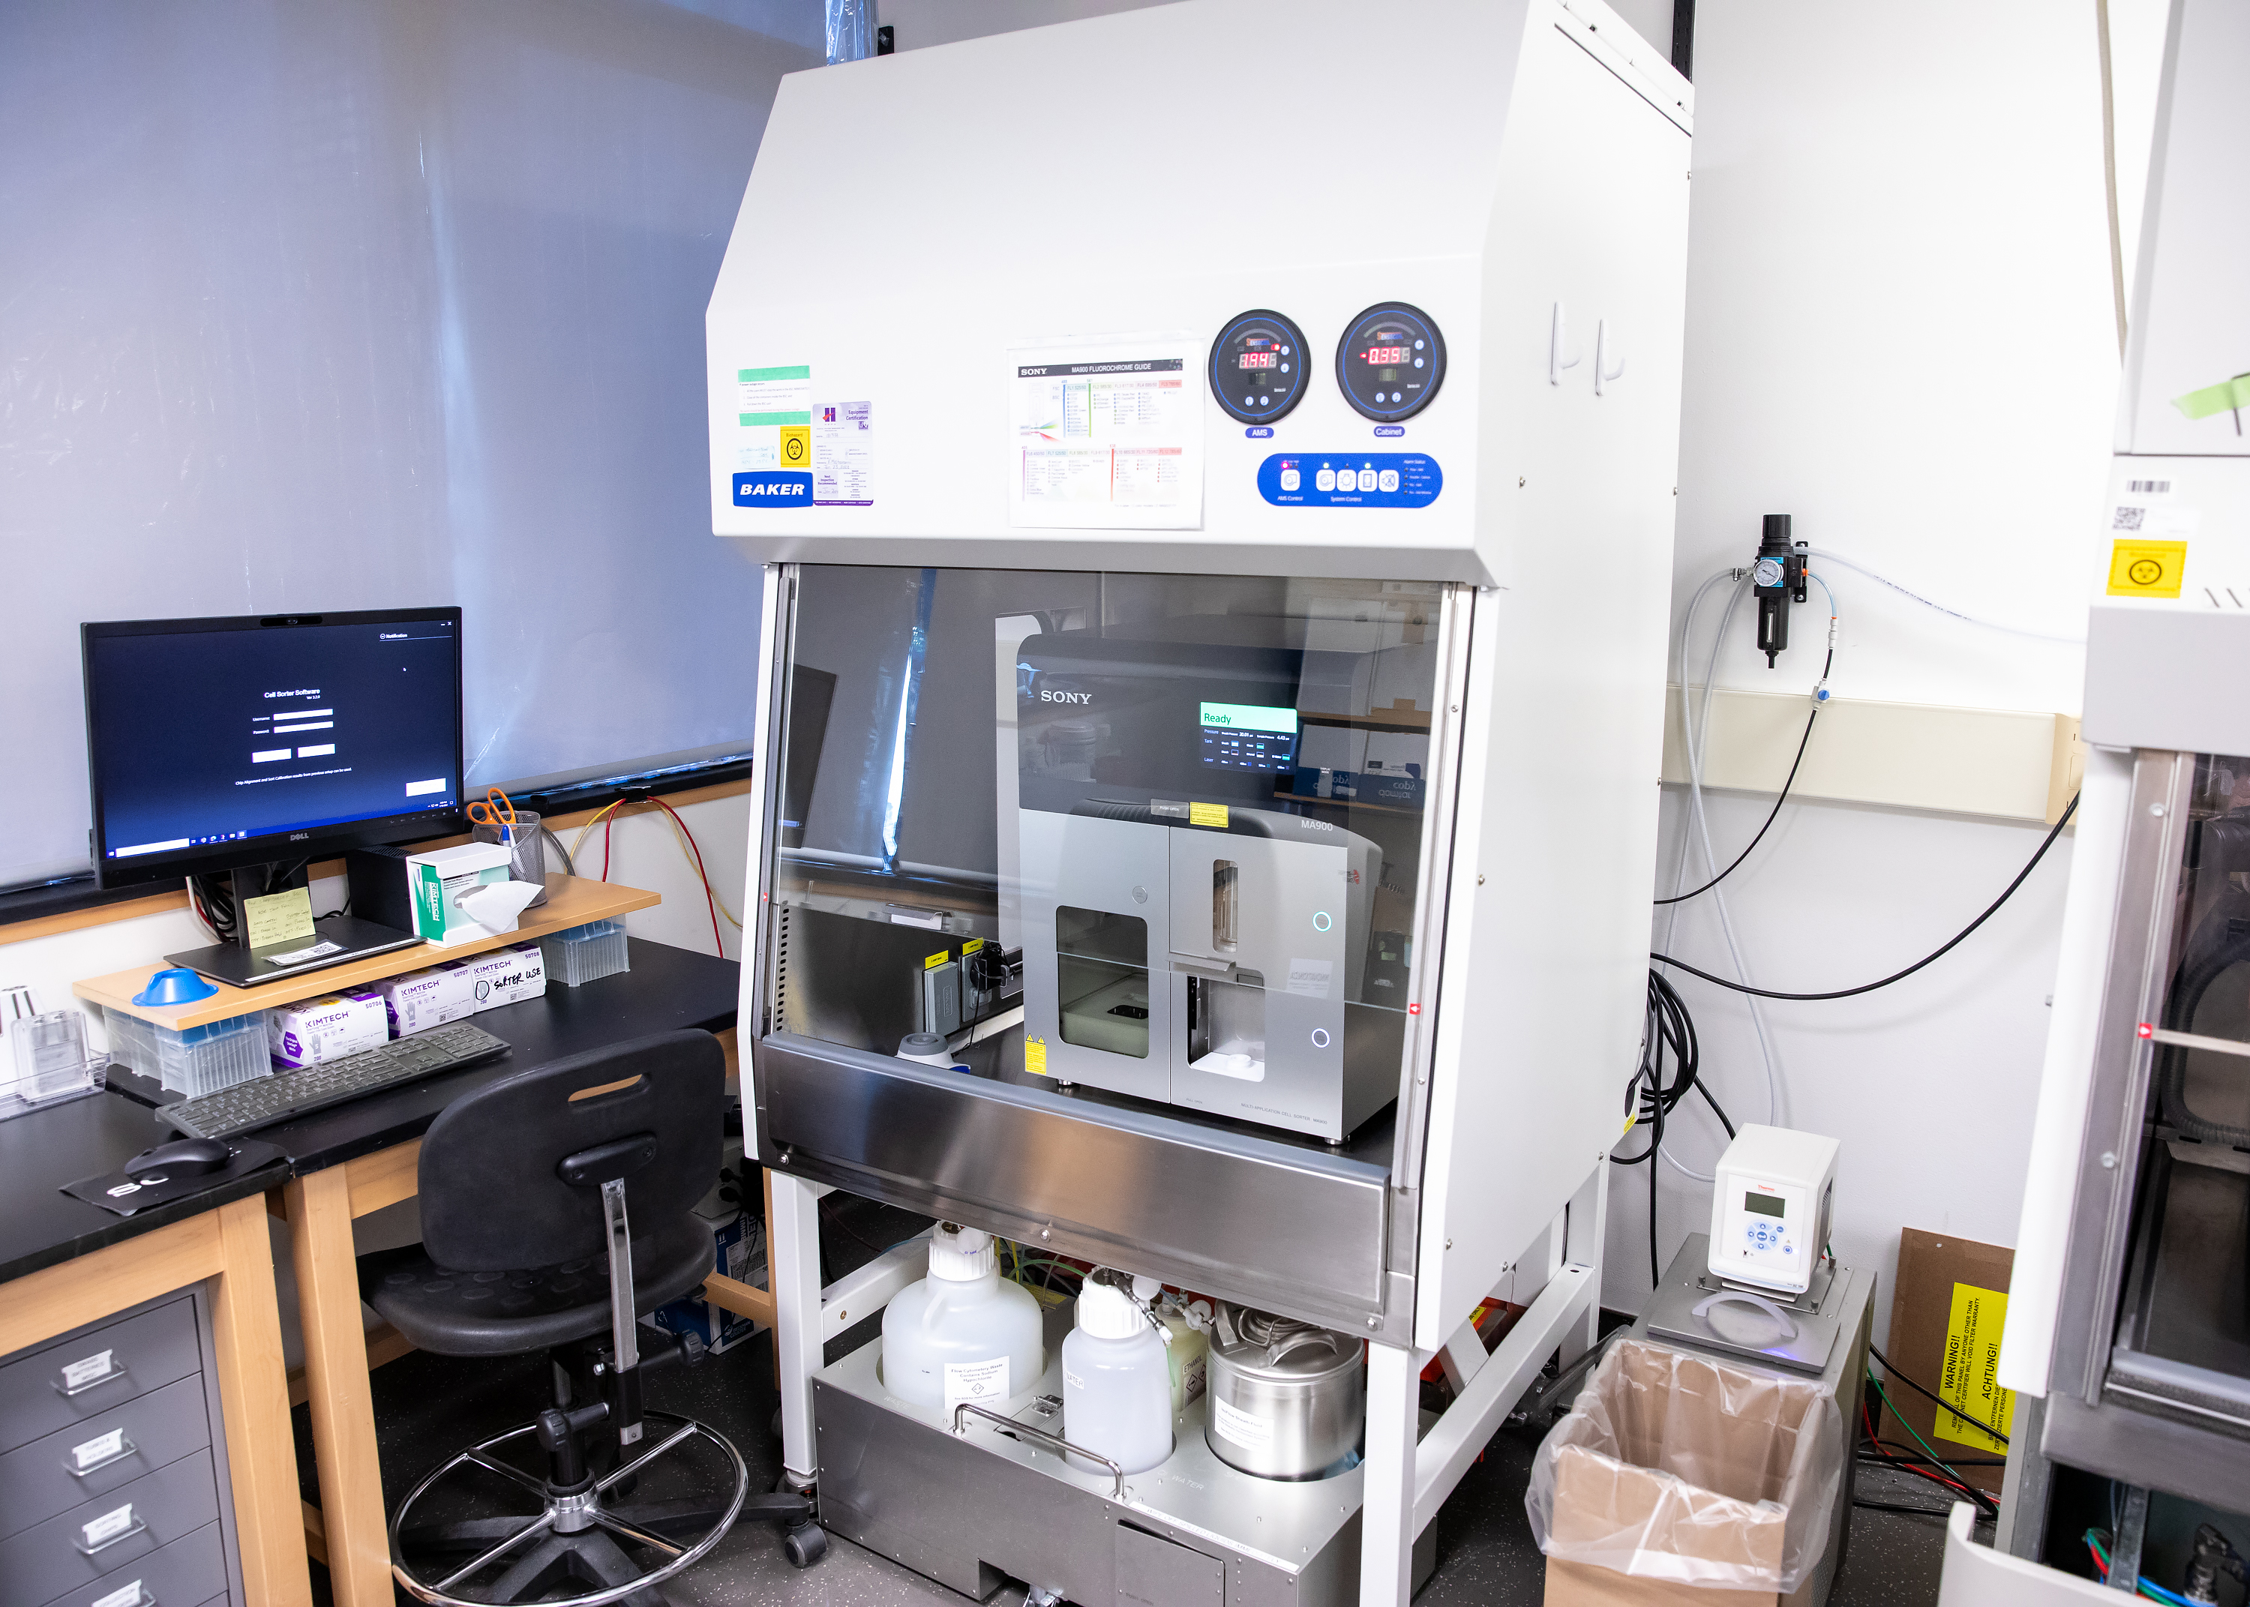
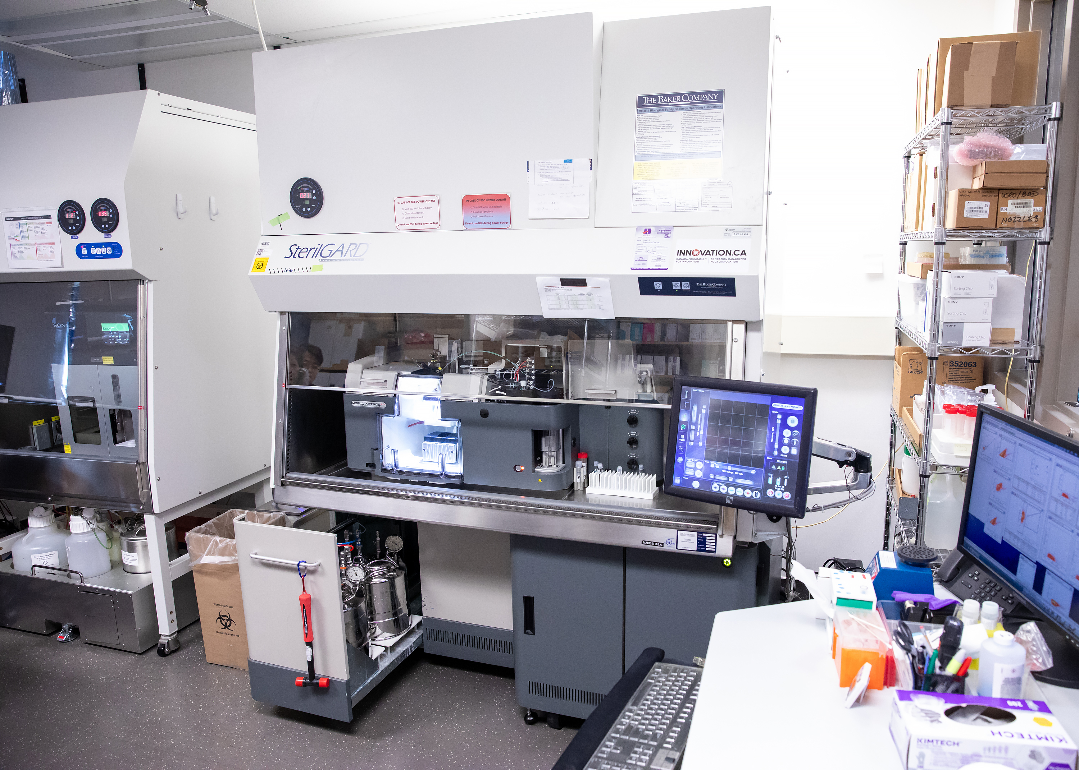
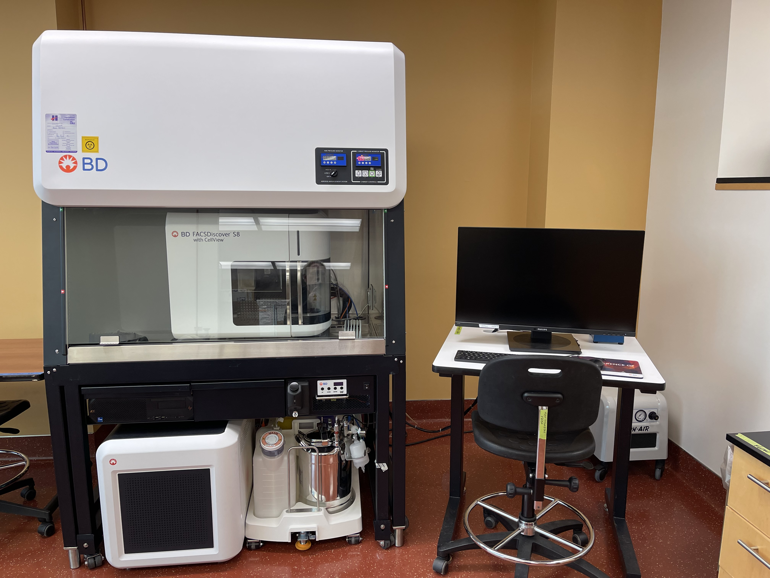



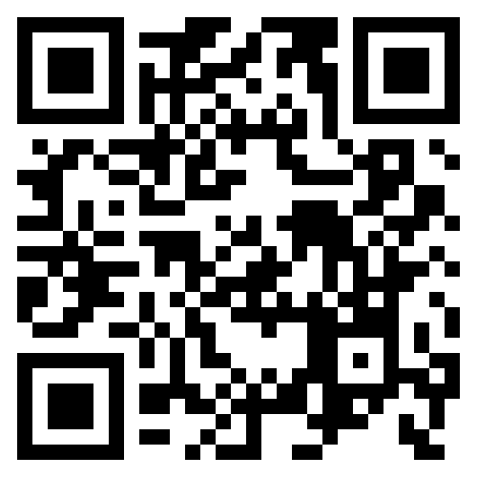


NBCC Flow Cytometry
We are a shared resource facility with many years of expertise providing a variety of flow cytometry analyzers and cell sorters, specializing in Imaging Flow Cytometry
BD Fortessa X-20 (HTS) 5 lasers-
18 color detectors/FS/SS
BD Fortessa (HTS) 4 lasers
14 color detectors/FS/SS
ANALYSER
ANALYSER
Michael Parsons
parsons@lunenfeld.ca
600 University Ave., MSH 980
Annie Bang
bang@lunenfeld.ca
25 Orde, L4-420-421
Coulter Gallios 4 lasers
10 color detectors/FS/SS
ThermoFisher Attune NxT (HTS) 4 lasers
16 color detectors/FS/SS
ANALYSER
ANALYSER
About us
Full suite analyzers/cell sorters
Full service and self-directed flow cytometry analysis and cell sorting available
Imaging flow cytometry with machine learning powered analysis
State of the art image enabled/spectral cell sorting
High level consultation, experimental design, troubleshooting, and data analysis
Comprehensive training from in depth theory to hands on instrument training
Amnis ImageStream 5 lasers-
10 color detectors/BF/DF
Sony MA900 4 lasers
12 color detectors/FS/BS
ANALYSER
CELL SORTER
Coulter MoFlo ASTRIOS EQ 5 lasers
18 color detectors/FS/SS
BD FACS Discover S8 5 lasers-Full Spectrum (78 color detectors)
CellView Imaging (3 color detectors/LL/FS/SS)
CELL SORTER
CELL SORTER
Cell Sorters (FACS)
Find us online:
nbcc.lunenfeld.ca

